Slide 1




MOBILEY PROJECT
Part 1

Slide 2
Presents:
Efrat Dahan
yashan
Oryan Tamsut
yashon
Pnini Winegarten
wolf
Efrat Granit
wolf

Slide 3
First idea
Kernel
Outline:
-1 | -1 | -1
-1 | 8 | -1
-1 | -1 | -1

Slide 4
First idea
Kernel
Good:
Find traffic lights,
ignore the sky
Problem:
Didn’t cover enough…

Slide 5
Second idea
Kernel
High pass:
Size 35x35
… | … | … | … | … | … | …
… | -1/1225 | -1/1225 | -1/1225 | -1/1225 | -1/1225 | …
… | -1/1225 | -1/1225 | -1/1225 | -1/1225 | -1/1225 | …
… | -1/1225 | -1/1225 | -1/1225 | -1/1225 | -1/1225 | …
… | -1/1225 | -1/1225 | 1224/1225 | -1/1225 | -1/1225 | …
… | -1/1225 | -1/1225 | -1/1225 | -1/1225 | -1/1225 | …
… | -1/1225 | -1/1225 | -1/1225 | -1/1225 | -1/1225 | …
… | … | … | … | … | … | …

Slide 6
Second idea
Kernel
Good:
Find traffic lights
Problem:
Identified a lot of junk …

Slide 7

Improvement for the second idea
High pass circle:
Size 27x27
Problem: does not complete to 0

Slide 8
Improvement for the second idea
Normalize the picture
Increase 100 from all in order the black will be negative
Increase the average
Divide by the max

Slide 9
Second idea
Kernel
Problem:
Didn’t identify the small traffic lights
Solution:
2 kernels

Slide 10


Improvement for the second idea
High pass circle kernel big:
Size 11x11
High pass circle kernel small:
Size 25x27

Slide 11





More kernels by the way…

Slide 12
Find max points

Slide 13
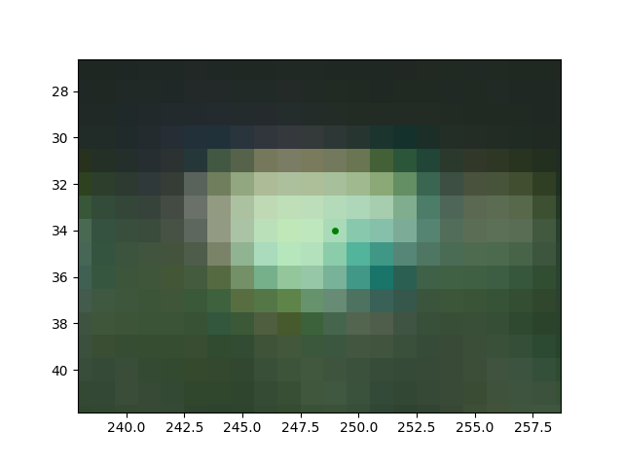
Sort the points found by the filter into red and green colors

Slide 14
Runnig example

Slide 15
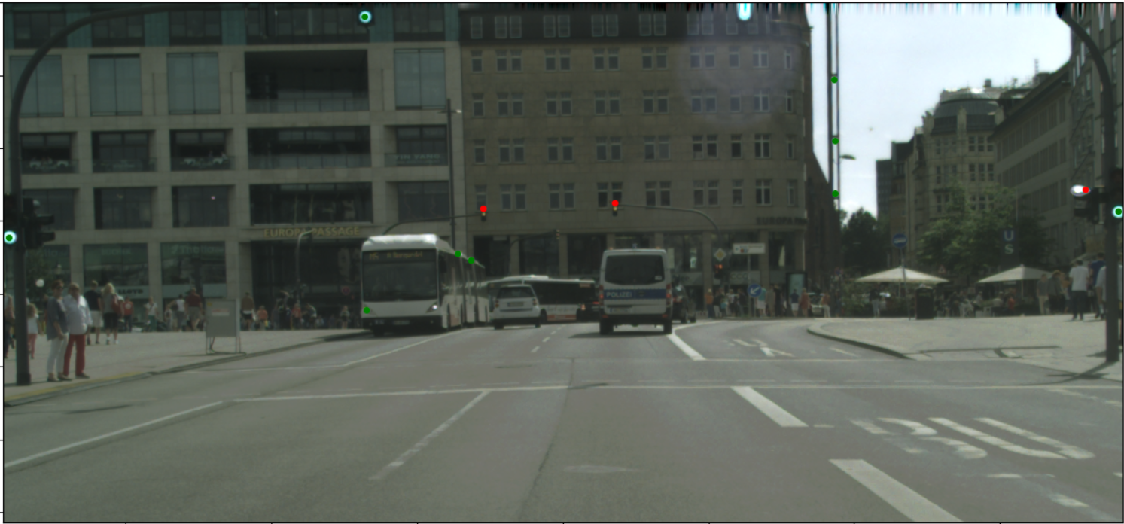
Runnig example

Slide 16
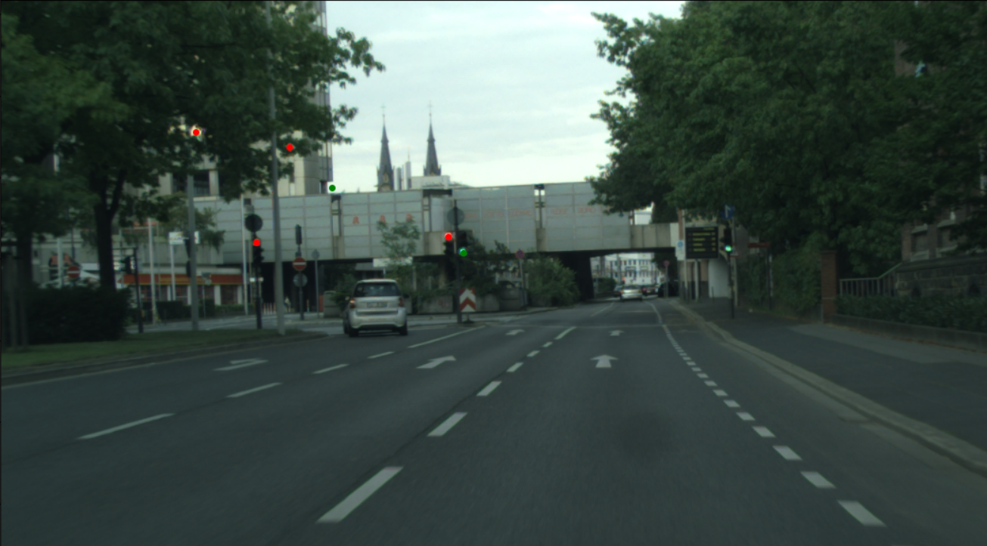
Runnig example

Slide 17
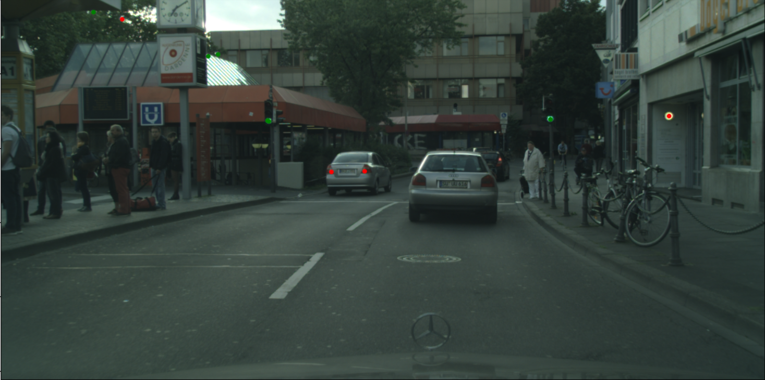
Runnig example

Slide 18
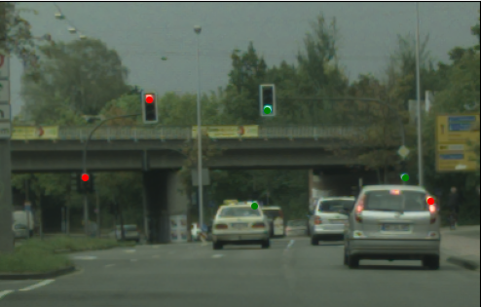
Runnig example

Slide 19
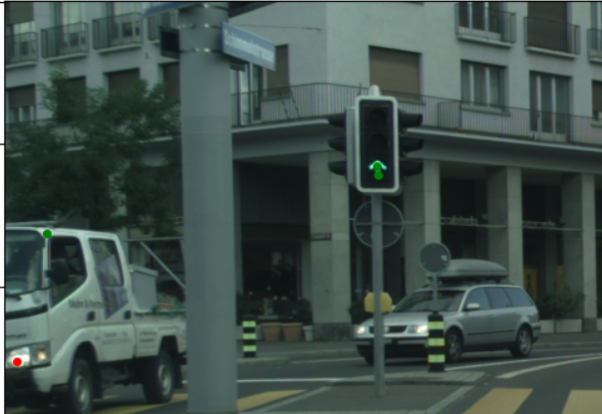
Runnig example

Slide 20
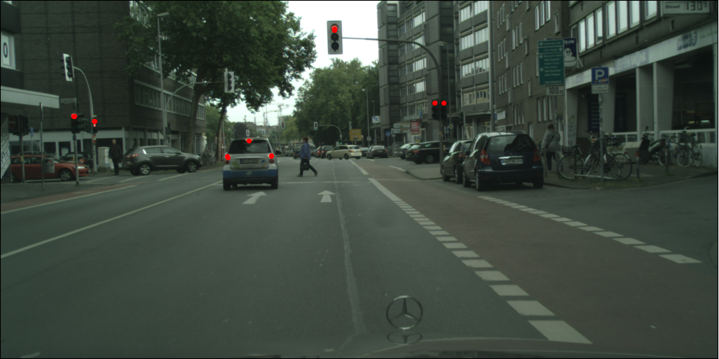
Runnig example

